Slide 1

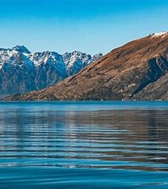
a new strategy for ClimateWins: predicting weather variations using machine learning
Innocent Bayai
December 2024

Slide 2

Overview & objectives
ClimateWins is a small European nonprofit organization interested in mitigating climate change-related disasters.
ClimateWins is interested in using machine learning to help predict the consequences of climate change around Europe and, potentially, the world.
This project seeks to:
Identify weather patterns outside the regional norm in Europe.
Determine if unusual weather patterns are increasing.
Generate possibilities for future weather conditions over the next 25 to 50 years based on current trends.
Determine the safest places for people to live in Europe over the next 25 to 50 years.

Slide 3


Thought experiments & Machine learning approaches
The thought experiments vs the machine learning options adopted are as follows:
Identification and classification of unusual weather conditions that are likely to affect the safety of people.
Convolutional Neural Networks (CNNs)
Recurrent Neural Networks (RNNs)
Random Forests
Project future weather conditions in Europea.
Generative Adversarial Networks (GANs)
Identify safe places/towns/weather stations in the face of extreme effects of climate change
Based on GANs results on projected weather conditions, safe places/towns/weather stations can be identified.

Slide 4
Convolutional Neural Networks (CNN)
CNNs can read and classify spatial hierarchical patterns in weather data either from satellite images or high dimensional numerical data.
The accuracy of the optimized CNNs model is 98.62% - indicating a close to accurate prediction of weather
The confusion matrix shows that most predictions are correct.
The higher the model accuracy, (98.62%) the better the weather prediction power.
The lower the model loss, the more accurate the model.

Slide 5
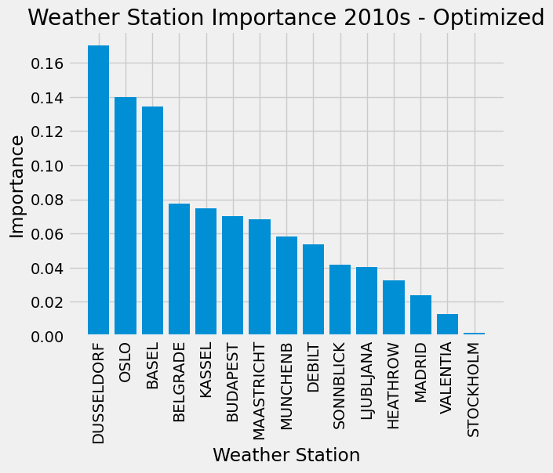
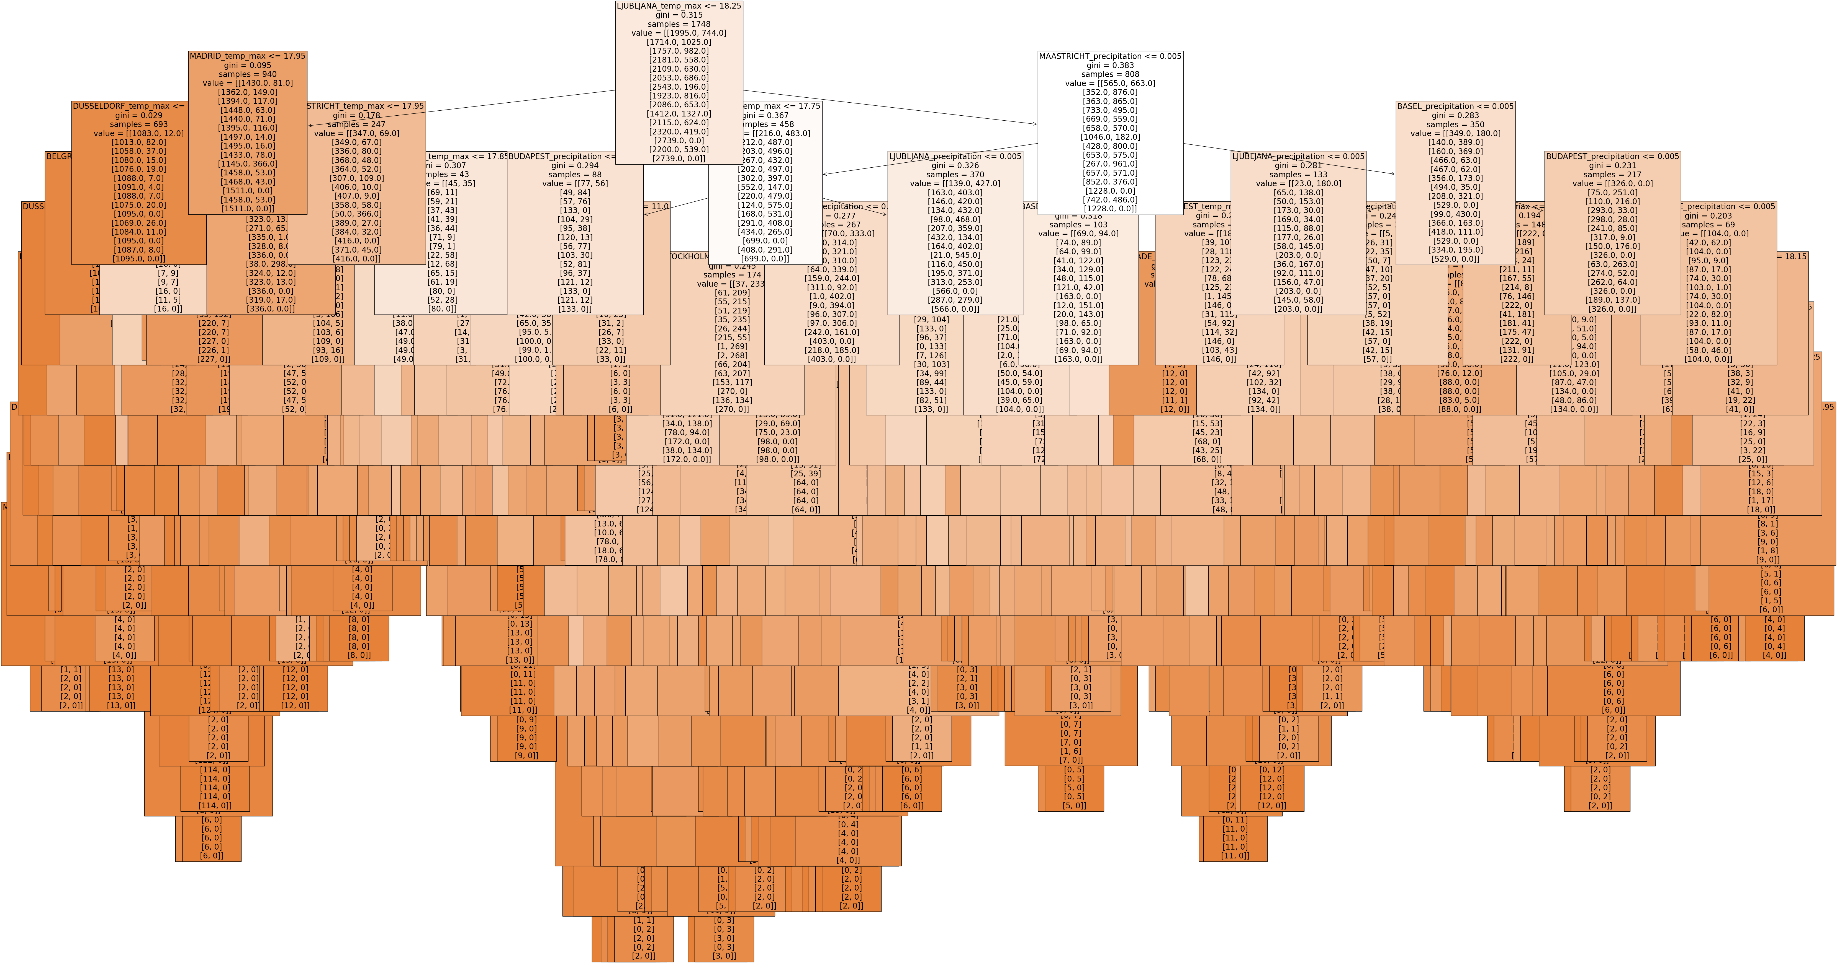
Random Forests model
Random Forests – rely on the interaction of multiple weather features to predict weather outcomes.
The most important weather features (temp, rains, etc) for each station are identified.
Runs several decision trees and combine the predictions to get an averaged-out weather condition.
The optimized random forest for all weather stations from 2010 to 2019 shows that:
The accuracy of the optimized model is 66%.
The important weather stations are Dusseldorf, Oslo and Basel.
The most important weather elements for top three stations are: temperature, precipitation, and average temperature.

Slide 6
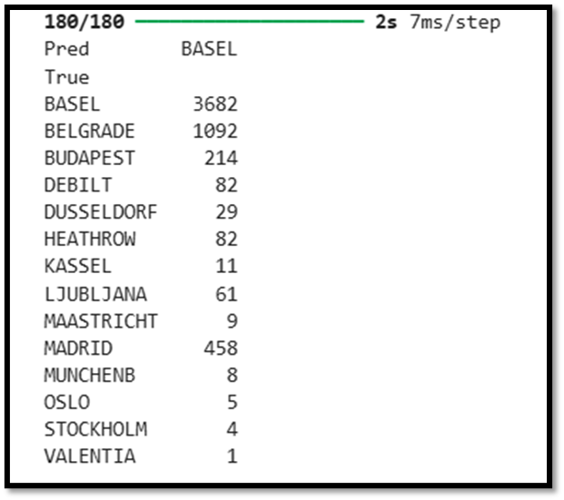
Recurrent Neural Networks (RNN)
Deep learning model with RNNs can predict weather through sequential prediction.
Can use time series weather data to predict future weather conditions.
Prior optimization, RNN model shows 62% accuracy.
The confusion matrix misses one weather station out of the 15!
The RNN model requires optimization to increase its accuracy by limiting the model losses.

Slide 7
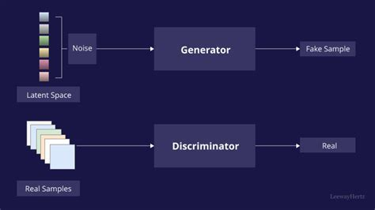
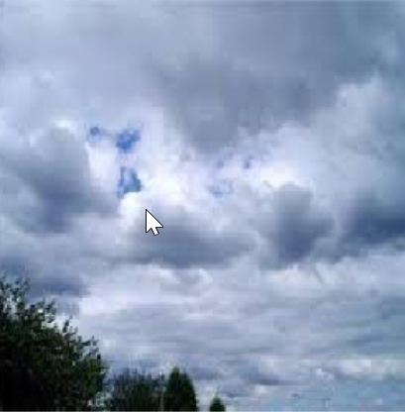
Generative Adversarial Networks (GANs)
GANs project future weather conditions through two different neural networks (generator and discriminator) working against each other.
As per ClimateWins’ alignment, GANs can predict future weather conditions (25-50 years).
RNN can be trained on GANs synthetic weather data.
Merits
It is possible to identify safe locations/towns/weather stations in advance and execute a plan of moving people to safe place.
More data generated by the generator makes it easy to simulate the future.

Slide 8
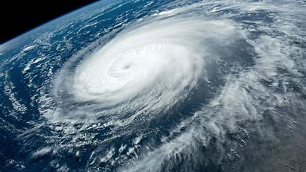
Additional data needs
Beyond the historical data, the following weather data is critical:
High resolution satellite weather images – CNNs can detect potential cyclones/frontal systems, storms,
Current weather data (temp, rains, pressure etc) – this can be used to update models and perfect their training for better prediction.
For a global weather forecast, ClimateWins requires localized ground-based weather stations for multiple locations.
Geographical information and topography data – mountains, valleys, rivers etc influence weather patterns
Global atmospheric data (weather models) – Numerical Weather Prediction (NWP) models and global atmospheric systems such as the jet stream, pressure systems, and climate oscillations (e.g., El Niño, La Niña).

Slide 9
Recommendations
For a comprehensive forecast of weather across the world, ClimateWins requires the collection of weather data across the globe.
Satellite data can be optimized in weather forecasting using CNNs.
CNNs can achieve high accuracy levels
Develop GANs model for predicting future weather conditions and identification of safe places.

Slide 10

nncntb9@gmail.com

